Slide 1
Multi-Armed Bandits
Scott O’Hara
Metrowest Boston Developers Machine Learning Group
02/12/2020

Slide 2
References
The material for this talk is primarily drawn from these resources:
R. S. Sutton and A. G. Barto, Reinforcement learning: an introduction, Second edition. Cambridge, Massachusetts: The MIT Press, 2018.
M. White and A. White, “Fundamentals of Reinforcement Learning,” Coursera. [Online]. Available: https://www.coursera.org/specializations/reinforcement-learning#courses. [Accessed: 14-Feb-2020].
R. Dechter, “CompSci 295 Reinforcement Learning, Fall 2019, UC Irving.” [Online]. This is a graduate-level seminar with pointers to many advanced resources on reinforcement learning. Available: https://www.ics.uci.edu/~dechter/courses/ics-295/fall-2019/. [Accessed: 14-Feb-2020]
S. Arora and E. Hazan, “Machine Learning and Artificial Intelligence.” [Online]. Available: https://www.cs.princeton.edu/courses/archive/fall16/cos402/. [Accessed: 14-Feb-2020].

Slide 3
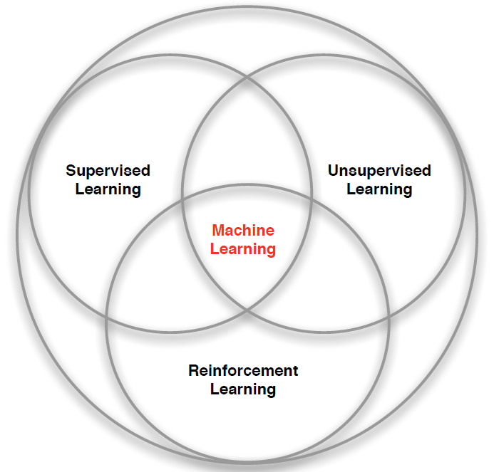
3 Types of Machine Learning
Supervised Learning – Learn a function from labeled data that maps input attributes to an output label e.g., linear regression, decision trees, SVMs.
Unsupervised Learning – Learn patterns in unlabeled data e.g., principle component analysis or clustering algorithms such as K-means, HAC, or Gaussian mixture models.
Reinforcement Learning – An agent learns to maximize rewards while acting in an uncertain environment.
Credit: image borrowed from lecture slides David Silver, DeepMind, “Introduction to Reinforcement Learning

Slide 4
Some Characteristics of Reinforcement Learning
Learning happens as the agent interact with the world.
There are no training or test sets. Training is guided by rewards and punishments obtained by acting in an environment.
The amount of data an agent receives is not fixed. More information is acquired as you go.
Actions are not always rewarded or punished immediately. “Delayed gratification” is possible.
Agent actions can affect the subsequent data it receives. E.g., closing a door that can’t be opened again.

Slide 5
MARKOV DECISION PROCESSES
The Markov Decision Process (MDP) provides a mathematical framework for reinforcement learning.
An MDP is used to model optimal decision-making in situations where outcomes are uncertain.
<https://en.wikipedia.org/w/index.php?title=Markov_decision_process&oldid=855934986> [accessed 11 September 2018]

Slide 6
The MDP decision framework
Markov decision processes model uncertainty
Use probability to model uncertainty about the domain.
Markov decision processes model an agent’s objectives
Use utility to model an agent’s objectives. The higher the utility, the “happier” your agent is.
Markov decision processes find an optimal decision policy
The goal is to discover an optimal decision policy π specifying how the agent should act in all possible states in order to maximize its expected utility.

Slide 7
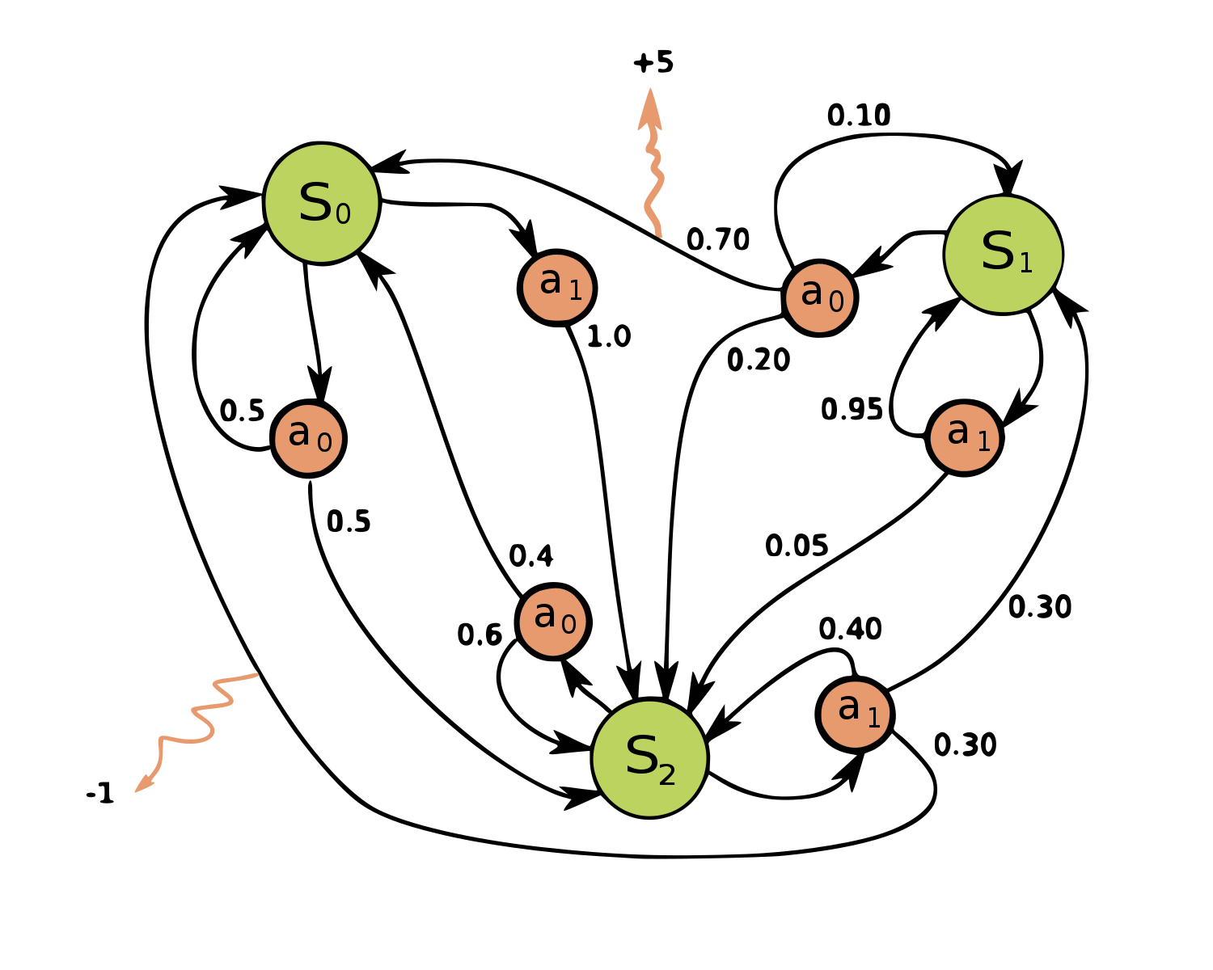
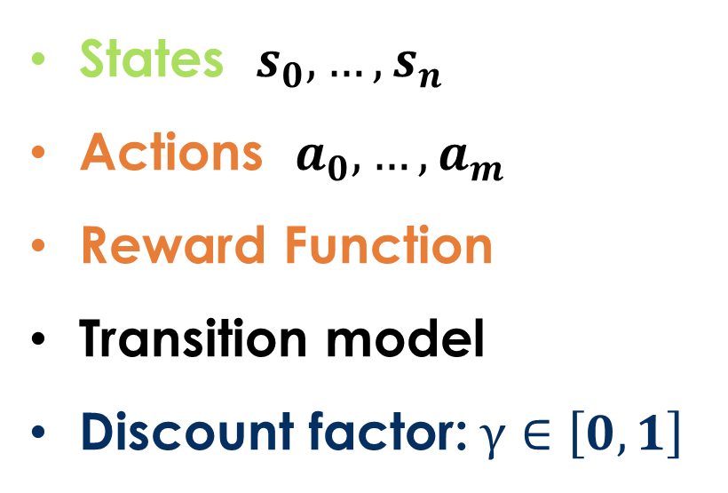
Markov decision processes
States: $s_{0},…,s_{n}$
Actions: $a_{0},…,a_{m}$
Reward Function:
Transition model:
Discount factor:$γ∈\left[0,1\right]$
<https://en.wikipedia.org/w/index.php?title=Markov_decision_process&oldid=855934986> [accessed 11 September 2018]

Slide 8
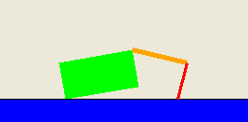
Application: Crawler robot
Arm1
Location
Arm2
States: <Location, Arm1 angle, Arm2 angle>
Actions: increase Arm1 angle, decrease Arm1 angle,
increase Arm2 angle, decrease Arm2 angle.
Reward Function: +1 if robot moves right, -1 if robot moves left.
Transition model: model of box movement caused by arm movements.

Slide 9
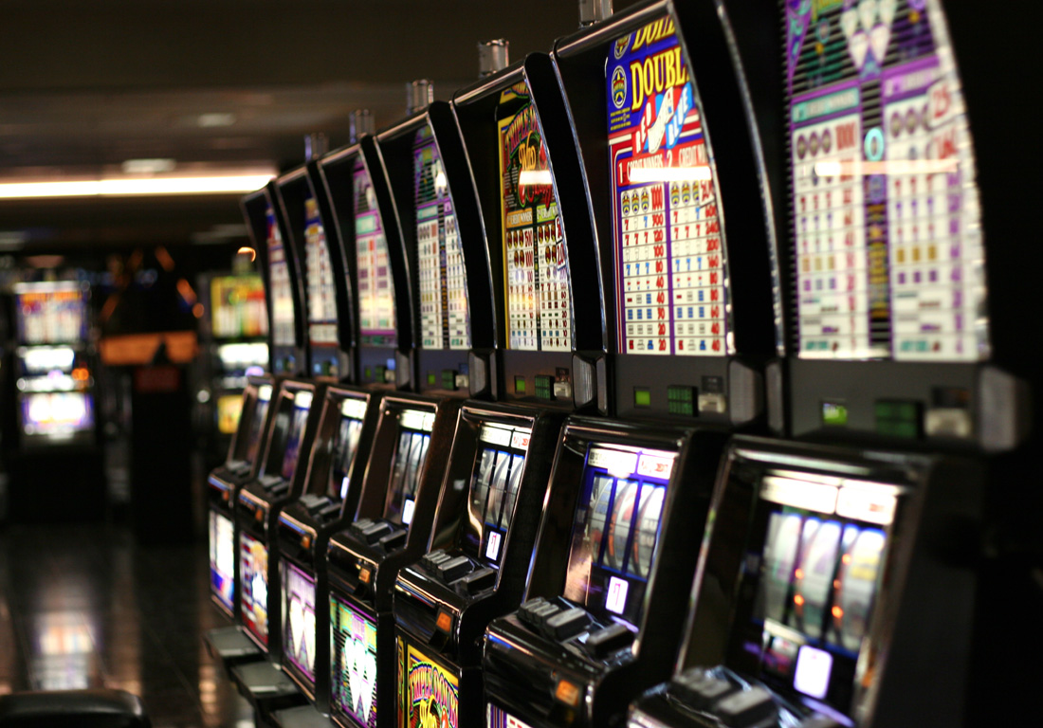
Application: The Multi-armed Bandit
A Simple Reinforcement Learning Problem
States: only 1 state
Actions: pull one of k arms
Reward Function: receive reward based on a probability distribution associated with each arm.
Transition model: no transitions
<https://en.wikipedia.org/w/index.php?title=Multi-armed_bandit&oldid=935049159> [accessed 12 February 2020]

Slide 10
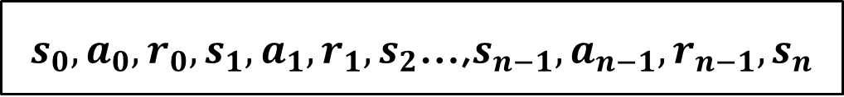
The Reinforcement Learning Problem
Environment
Reward
State
Action
Agent
$s_{0},a_{0},r_{0},s_{1},a_{1},r_{1},s_{2}$…,$s_{n−1},a_{n−1},r_{n−1},s_{n}$

Slide 11
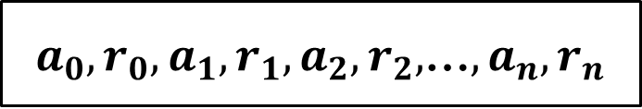
The Multi-Arm Bandit Learning Problem
Environment
Reward
Action
Agent
$a_{0},r_{0}, a_{1},r_{1},a_{2},r_{2},$…$,a_{n},r_{n}$

Slide 12
Why Study Multi-armed Bandits?
Multi-armed bandits can be used to create agents to solve real-world problems.
A simple model can make it easier to understand important issues that are hard to address using a more complex model.
Here, we will use multi-armed bandits to approach the exploration vs. exploitation trade-off in reinforcement learning.

Slide 13
Multi-armed bandit Applications
Medical treatment in clinical trials
Online ad placement
Webpage personalization
Network packet routing

Slide 14
choosing an action: exploration vs exploitation
How should an agent choose an action? An obvious answer is simply to follow the current policy. However, this is often not the best way to improve your model.
Exploit: use your current model to maximize the expected utility now.
Explore: choose an action that will help you improve your model.

Slide 15
How/When should we explore / exploit ?
How to Exploit? use the current policy.
How to Explore?
choose an action randomly
be optimistic about the rewards you will receive.
choose an action you have used less often
When to exploit? When to explore? How much time in exploration vs time in exploitation?

Slide 16
5 multi-armed Bandit Algorithms
Greedy
ϵ-Greedy
Greedy with optimistic initial values
ϵ-Greedy with decreasing ϵ.
Upper-confidence bound (UCB) action selection

Slide 17

Greedy Method
At time t, estimate the expected value for each action:
$$Q_{t}\left(a\right)=\frac{\text{Sum} \text{of} \text{rewards} \text{when} \text{action} \text{a} \text{is} \text{taken} \text{prior} \text{to} \text{t}}{\text{Number} \text{of} \text{times} \text{action} \text{a} \text{is} \text{taken} \text{prior} \text{to} \text{t}}$$
Select the action with the maximum value.
$$A_{t}=argmax Q_{t}(a)$$

Slide 18
Greedy Method Weaknesses
Always exploits current knowledge, no exploration.
Can get stuck with a suboptimal action.

Slide 19

ϵ-Greedy Method
At time t, estimate the expected value for each action:
$Q_{t}\left(a\right)=\frac{\text{Sum} \text{of} \text{rewards} \text{when} \text{action} \text{a} \text{is} \text{taken} \text{prior} \text{to} \text{t}}{\text{Number} \text{of} \text{times} \text{action} \text{a} \text{is} \text{taken} \text{prior} \text{to} \text{t}}$
With probability 1 - ϵ, select the action with the maximum value.
$$A_{t}=argmax Q_{t}(a)$$
With probability ϵ, randomly select an action from all the actions with equal probability.

Slide 20

Experiments
Setup: (one run)
10-armed bandits
Draw $u_{i}$ from $Gaussian\left(0,1\right),i=1,…,10$
the expectation/mean of rewards for action i.
Rewards of action i at time t: $x_{i}(t)$
$x_{i}\left(t\right)\sim Gaussian(u_{i}$,1)
Play 2000 rounds/steps
Average return at each time step
Average over 1000 runs

Slide 21
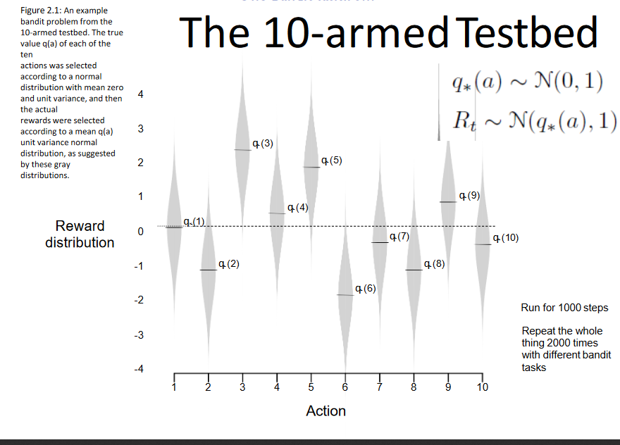

Slide 22
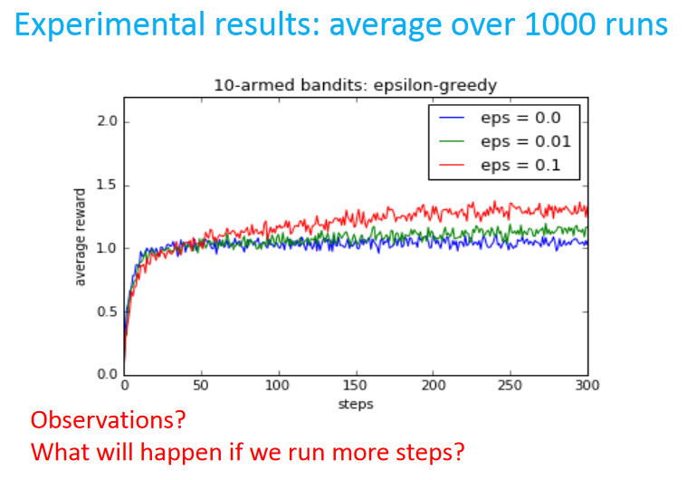

Slide 23
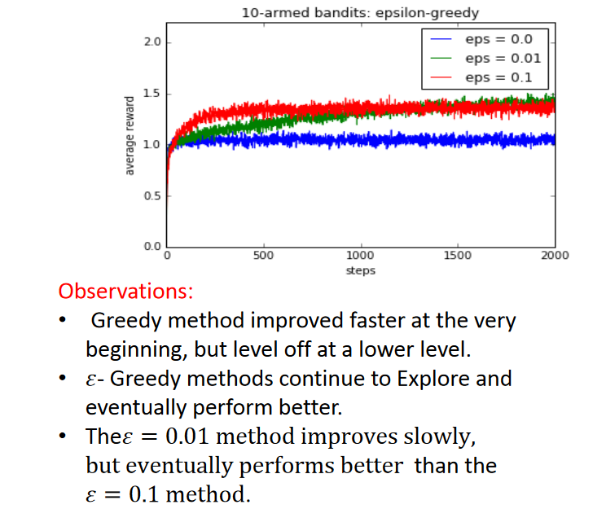

Slide 24
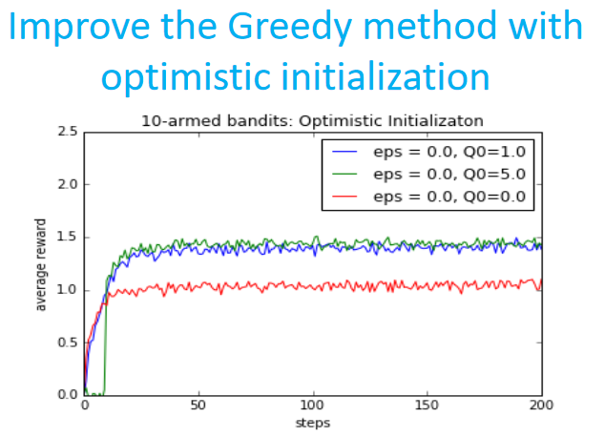

Slide 25
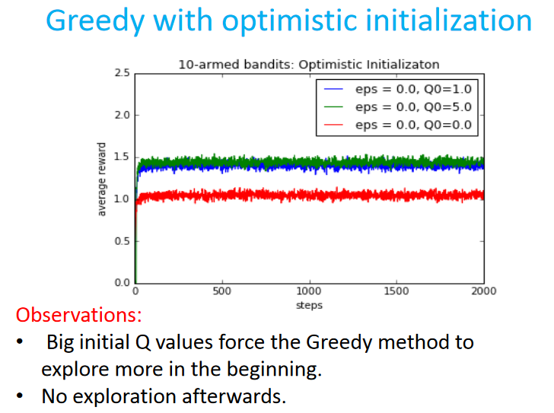

Slide 26
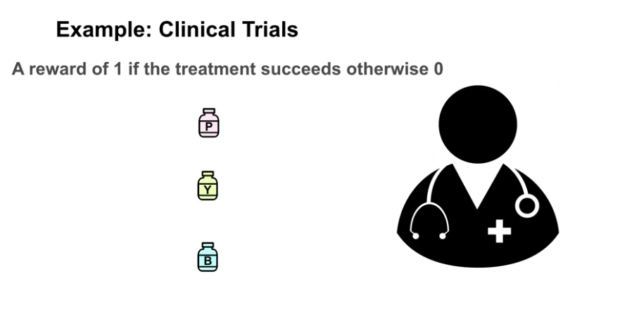
Borrowed from M. White and A. White, “Fundamentals of Reinforcement Learning,” Coursera.

Slide 27
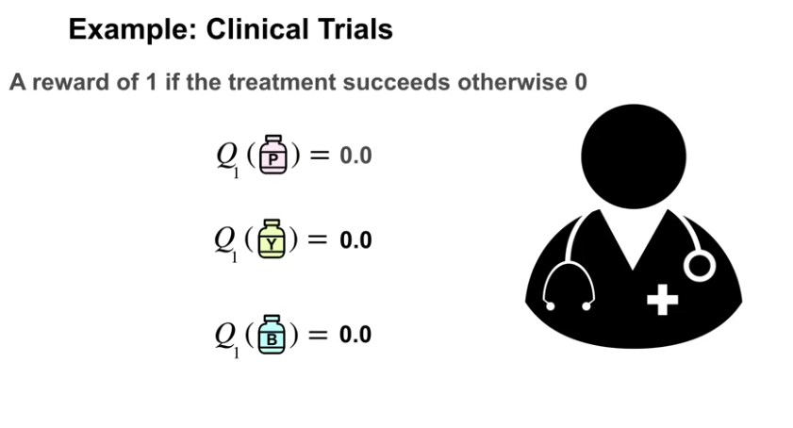
Borrowed from M. White and A. White, “Fundamentals of Reinforcement Learning,” Coursera.

Slide 28
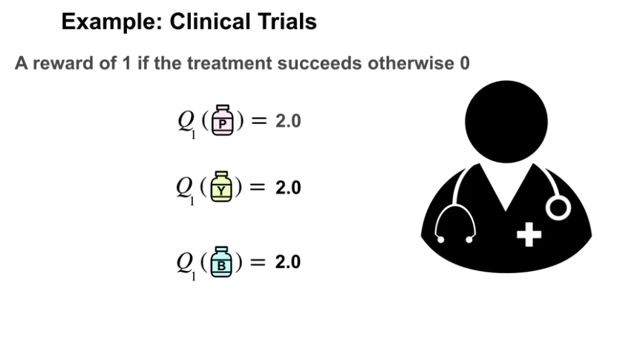
Borrowed from M. White and A. White, “Fundamentals of Reinforcement Learning,” Coursera.

Slide 29
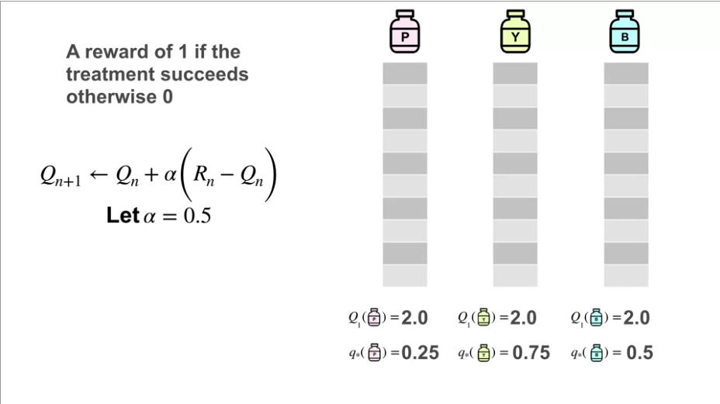
Borrowed from M. White and A. White, “Fundamentals of Reinforcement Learning,” Coursera.

Slide 30
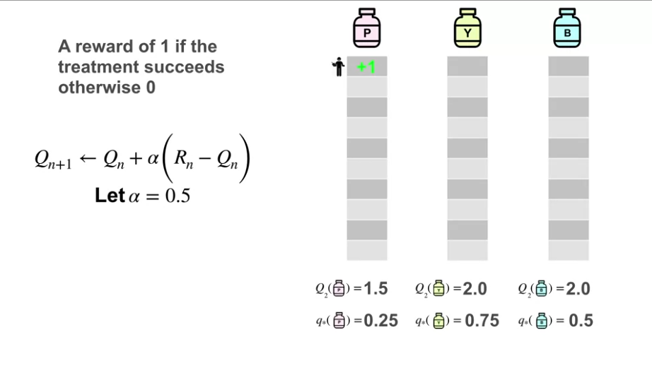
Borrowed from M. White and A. White, “Fundamentals of Reinforcement Learning,” Coursera.

Slide 31
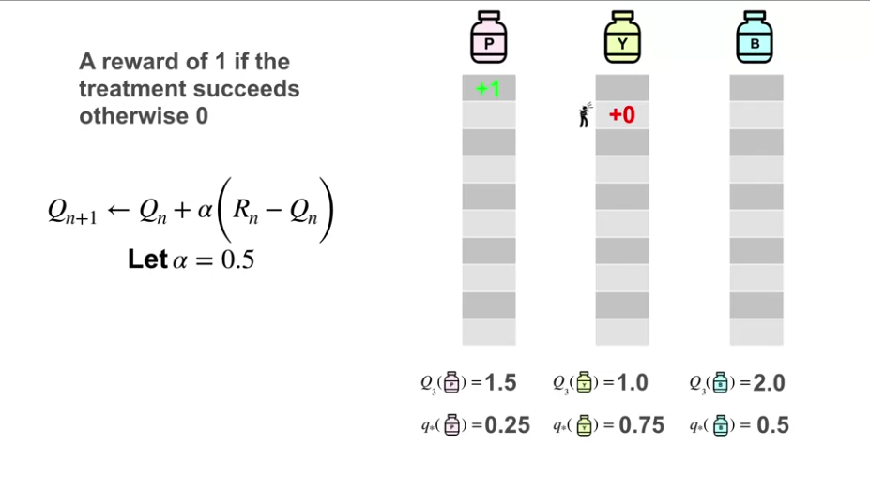
Borrowed from M. White and A. White, “Fundamentals of Reinforcement Learning,” Coursera.

Slide 32
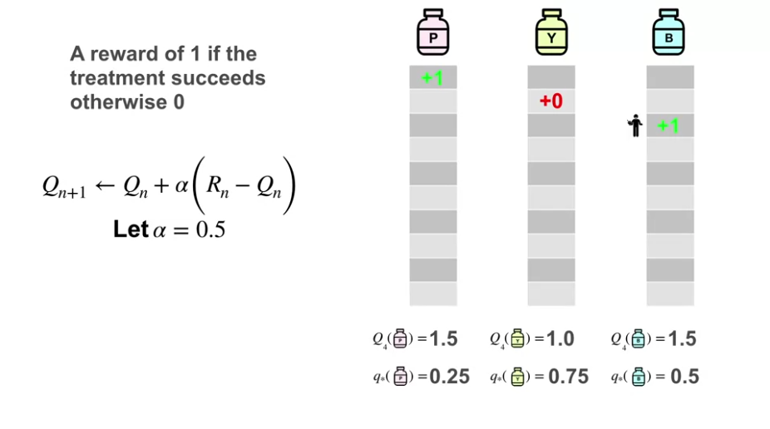
Borrowed from M. White and A. White, “Fundamentals of Reinforcement Learning,” Coursera.

Slide 33
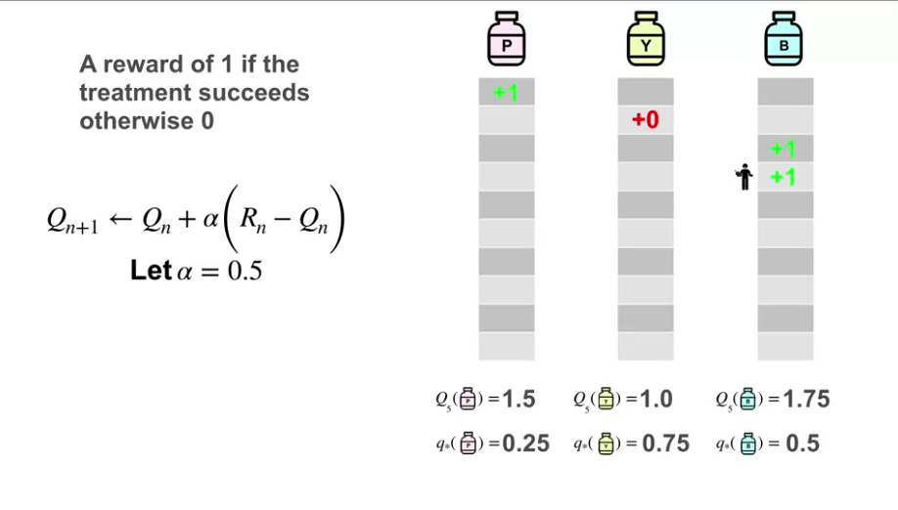
Borrowed from M. White and A. White, “Fundamentals of Reinforcement Learning,” Coursera.

Slide 34
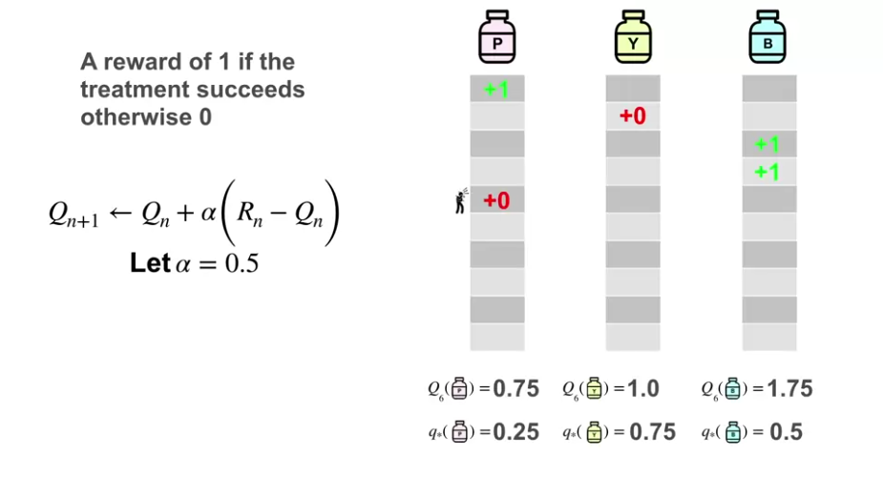
Borrowed from M. White and A. White, “Fundamentals of Reinforcement Learning,” Coursera.

Slide 35
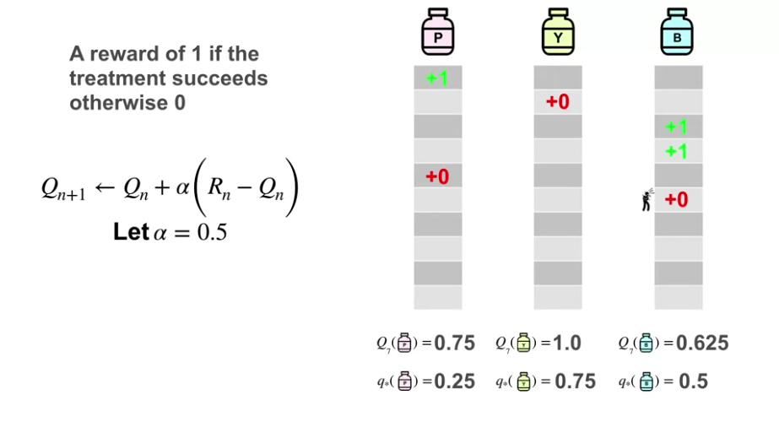
Borrowed from M. White and A. White, “Fundamentals of Reinforcement Learning,” Coursera.

Slide 36
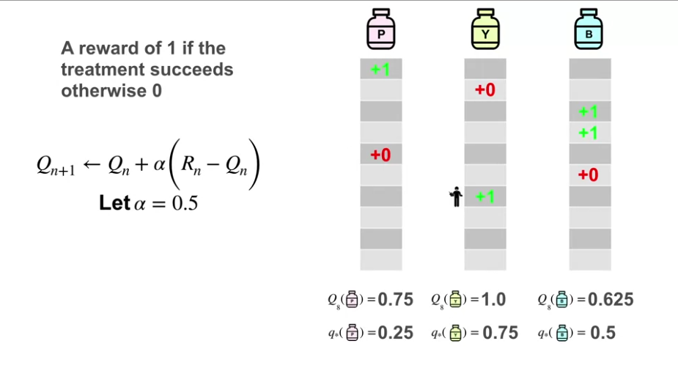
Borrowed from M. White and A. White, “Fundamentals of Reinforcement Learning,” Coursera.

Slide 37
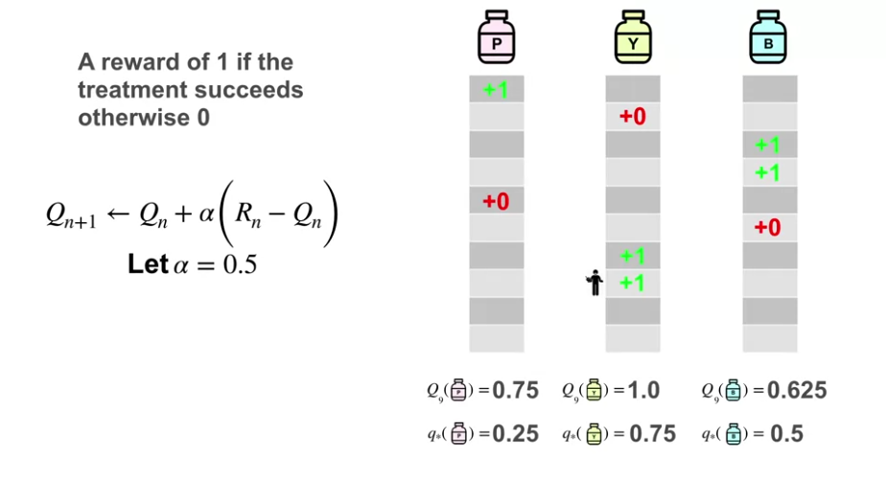
Borrowed from M. White and A. White, “Fundamentals of Reinforcement Learning,” Coursera.

Slide 38
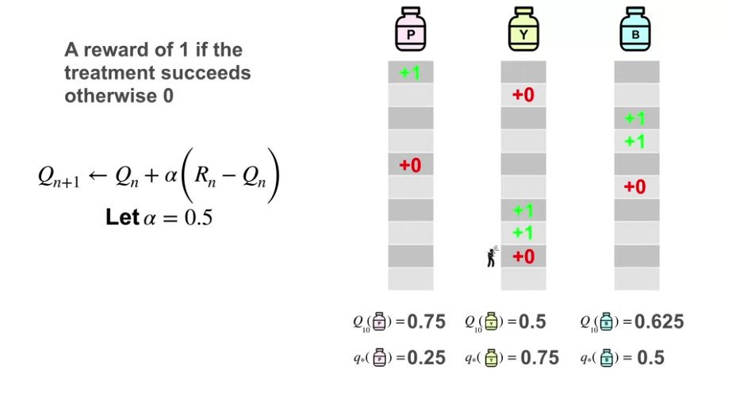
Borrowed from M. White and A. White, “Fundamentals of Reinforcement Learning,” Coursera.

Slide 39
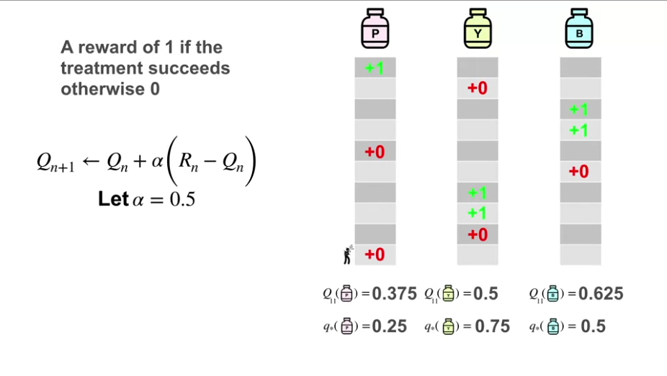
Borrowed from M. White and A. White, “Fundamentals of Reinforcement Learning,” Coursera.

Slide 40
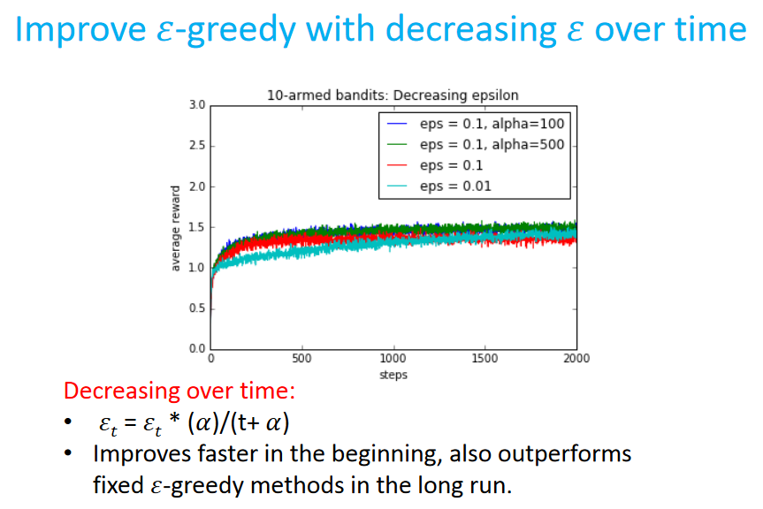
Borrowed from M. White and A. White, “Fundamentals of Reinforcement Learning,” Coursera.

Slide 41
ϵ-Greedy Method Weaknesses
Randomly selects an action to explore, does not explore more “promising” actions.
Does not consider prior experience with an action. If an action has been taken many times, there is less need to explore it.

Slide 42

Upper Confidence Bound (UCB) Algorithm
Take each action once.
At any time t > K,
- $A_{t}=\underset{a}{argmax}{(Q_{t}\left(a\right) +}c\sqrt{\frac{\ln{t}}{N_{a}\left(t\right)}})$, where
$Q_{t}\left(a\right)$is the average reward obtained from action a.
$N_{a}\left(t\right)$ is the number of times action a has been taken.
c is a user-specified parameter that controls the amount exploration that takes place.

Slide 43

Upper Confidence Bound (UCB) Algorithm
$A_{t}=\underset{a}{argmax}{(Q_{t}\left(a\right) +}c\sqrt{\frac{\ln{t}}{N_{a}\left(t\right)}})$,
Exploitation
Exploration

Slide 44
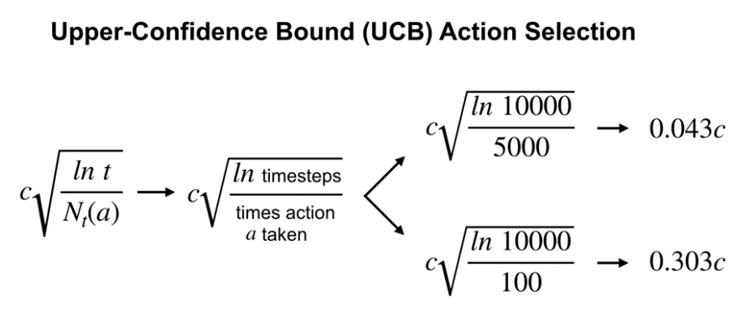

Slide 45

Upper Confidence Bound (UCB) Algorithm
$A_{t}=\underset{a}{argmax}{(Q_{t}\left(a\right) +}c\sqrt{\frac{\ln{t}}{N_{a}\left(t\right)}})$
$c\sqrt{\frac{\ln{t}}{N_{a}\left(t\right)}}$ is the confidence interval for the average reward.
Small $N_{a}\left(t\right)$ indicates a large confidence interval i.e., $Q_{t}\left(a\right)$is more uncertain.
Large $N_{a}\left(t\right)$ indicates a small confidence interval i.e., $Q_{t}\left(a\right)$is more accurate.

Slide 46
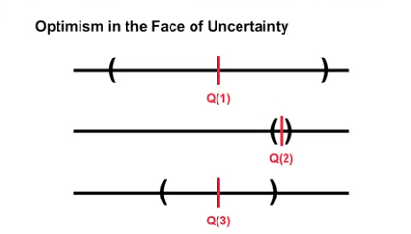
Borrowed from M. White and A. White, “Fundamentals of Reinforcement Learning,” Coursera.

Slide 47
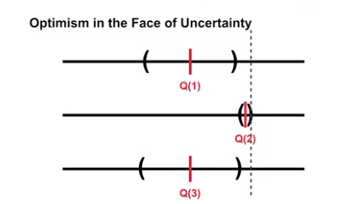
Borrowed from M. White and A. White, “Fundamentals of Reinforcement Learning,” Coursera.

Slide 48
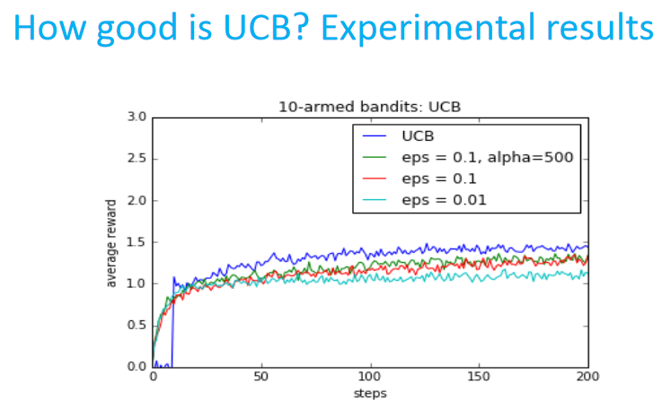

Slide 49
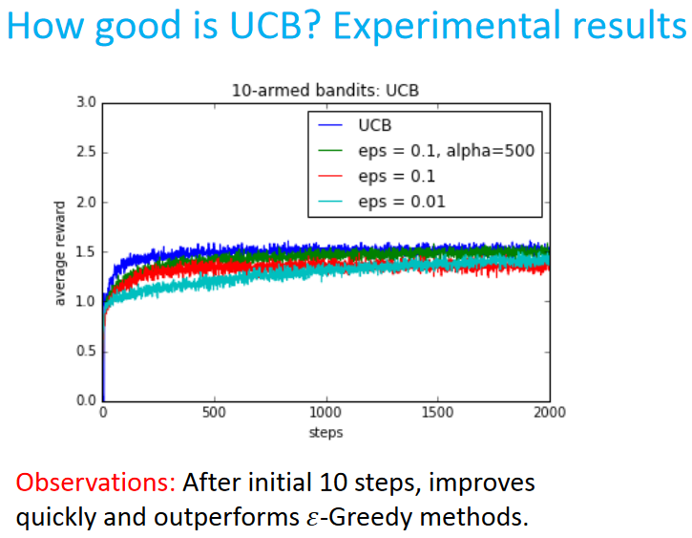

Slide 50
Multi-Armed Bandits
Scott O’Hara
Metrowest Boston Developers Machine Learning Group
02/12/2020

